Slide 1
Internet Control Message Protocol version 6 (ICMPv6)
Prepared by
Divya K S
Adi Shankara Institute of Engineering & Technology
Kalady

Slide 2
What is Internet Control Message Protocol (ICMP)?
The Internet Control Message Protocol (ICMP) is a network layer protocol used by network devices to diagnose network communication issues.
ICMP is mainly used to determine whether or not data is reaching its intended destination in a timely manner.
Commonly, the ICMP protocol is used on network devices, such as routers. ICMP is crucial for error reporting and testing.
Internet Control Message Protocol version 6 (ICMPv6) is the implementation of the Internet Control Message Protocol (ICMP) for Internet Protocol version 6 (IPv6).

Slide 3
What is ICMP used for?
The primary purpose of ICMP is for error reporting. When two devices connect over the Internet, the ICMP generates errors to share with the sending device in the event that any of the data did not get to its intended destination.
A secondary use of ICMP protocol is to perform network diagnostics; the commonly used terminal utilities traceroute and ping both operate using ICMP.
The traceroute utility is used to display the routing path between two Internet devices.
The ping utility is a simpliﬁed version of traceroute. A ping will test the speed of the connection between two devices and report exactly how long it takes a packet of data to reach its destination and come back to the sender’s device.

Slide 4
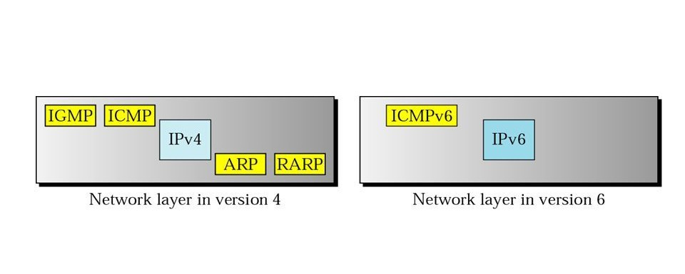
Comparison of network layers in version 4 and version 6
Internet Group Management Protocol-IGMP
Internet Control Message Protocol -ICMP
Address Resolution Protocol -ARP
Reverse Address Resolution Protocol -RARP

Slide 5
Message types and formats
ICMPv6 messages may be classified as error messages and information messages.
The ICMPv6 message consists of a header and the protocol payload. The header contains only three fields: type (8 bits), code (8 bits), and checksum (16 bits).
Type specifies the type of the message. Values in the range from 0 to 127 (high-order bit is 0) indicate an error message,
while values in the range from 128 to 255 (high-order bit is 1) indicate an information message.
The code field value depends on the message type and provides an additional level of message granularity.
The checksum field provides a minimal level of integrity verification for the ICMP message.

Slide 6
The ICMPv6 message consists of a header and the protocol payload.
The header contains only three fields: type (8 bits), code (8 bits), and checksum (16 bits).

Slide 7
ICMPv6 Error Messages
"Destination Unreachable"
“Packet Too Big"
"Time Exceeded”
"Parameter Problem"
“Redirection”

Slide 8
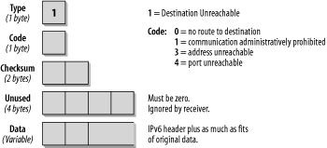
1. "Destination Unreachable"
Message is generated by the source host or a router when an IPv6 datagram packet cannot be delivered

Slide 9
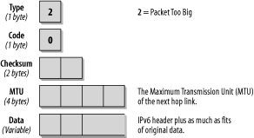
2."Packet Too Big"
If a router receives a datagram that is larger than the maximum transmission unit (MTU) size of the network through which the datagram should pass, two things happen. First, the router discards the datagram and then an ICMP error packet-a packet-too-big message-is sent to the source.
MTU (Maximum Transmission Unit) is the size of the largest protocol data unit that is supported over the link.

Slide 10
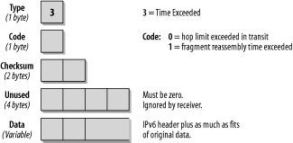
3."Time Exceeded"
IPv6 header includes a Hop Limit field.
The Hop Limit field value in IPv6 header is used to prevent routing loops.
Hop Limit field in IPv6 datagram header is decremented by each router that forwards the packet.
When the Hop Limit field value in IPv6 header reaches zero, the router discards the IPv6 datagram packet and returns a "Time Exceeded" ICMPv6 error message to the source host.

Slide 11
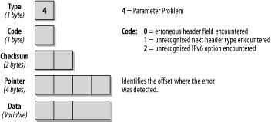
4."Parameter Problem"
Message is typically related with the problems and mistakes related with IPv6 header itself.
When a problem or mistake with an IPv6 header make a router cannot process the packet, the router stops processing the IPv6 datagram packet, discards the packet and returns a "Parameter Problem" ICMPv6 error message to the source host.

Slide 12
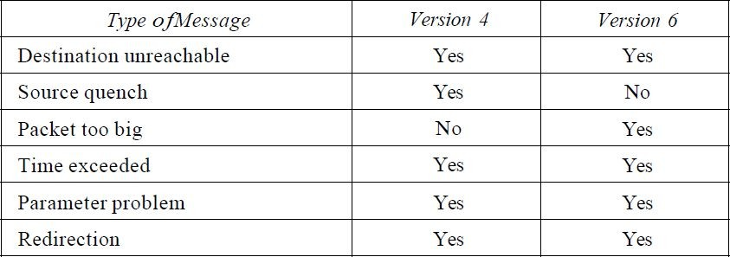
5.Redirection
The IPv6 Redirect Messages feature enables a device to send Internet Control Message Protocol (ICMP) IPv6 neighbor redirect messages to inform hosts of better first-hop nodes (devices or hosts) on the path to a destination.
Comparison of error-reporting messages in ICMPv4 and ICMPv6

Slide 13
ICMPv6 Query Messages
Echo request and Reply
Router Solicitation and advertisement
Neighbor Solicitation and advertisement
Group membership

Slide 14
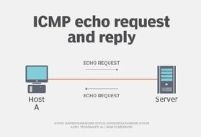
Echo Request
The Type field is set to 128, the value for the Echo Request.
The Code Field is not used for this message and is therefore set to 0. The Identifier and Sequence Number fields are used to match requests with replies.
The reply contain the same numbers as the request.
Whether an identifier and a sequence number are used and what kind of arbitrary data is included in the Echo Request depends on the TCP/IP stack you are using.

Slide 15
Echo Reply
The Type field contains the value 129 for Echo Reply. The Code field is unused and set to 0.
The Identifier and Sequence Number fields must match the fields in the request.
The data of the Echo Request message must be copied into the reply entirely and unmodified.
Echo Request message was sent to a unicast address, the Source address of the Echo Reply message must be the same as the Destination address of the Echo Request message.

Slide 16
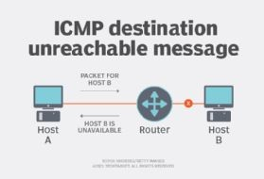
Neighbor Solicitation and advertisement
Improves and modified version of Ipv4
New functionality has been added which combines Address Resolution Protocol (ARP) and ICMP Router Discovery Protocol
Neighbor Unreachability Detection (NUD) mechanism has been defined. Duplicate IP address detection (DAD) has also been implemented.
IPv6 nodes use Neighbor Discovery
To find neighboring routers that can forward their packets
To keep track of which neighbors are reachable and which are not (NUD)
To detect changed link-layer addresses

Slide 17
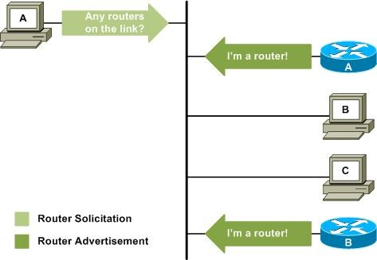
Router Solicitation and Advertisement
Routers send out Router Advertisement messages at regular intervals.
Hosts can request Router Advertisements by issuing a Router Solicitation message.

Slide 18
Group membership
•Network layer in version 4 contains an independent protocol called IGMP.
In version 6, this protocol is eliminated, and its duties are included in ICMPv6. The purpose is exactly the same

Slide 19
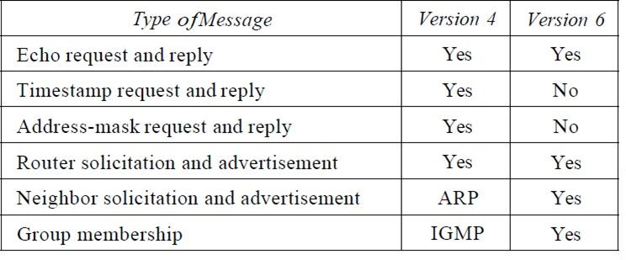
Comparison of query messages in ICMPv4 and ICMPv6

